Slide 1
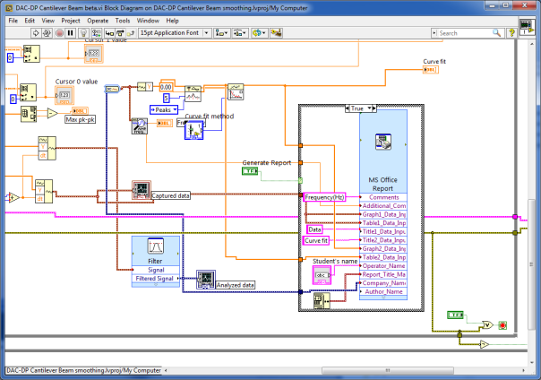
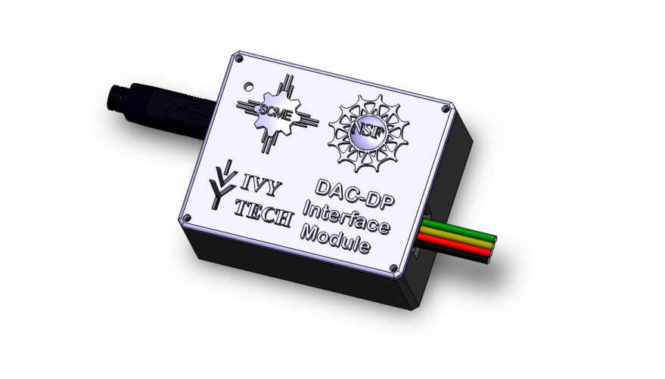


Using Arduino Uno and LabView to Learn MEMS Concepts
Andrew G. Bell
July 22, 2019
As the Internet of Things explodes, it is critical that
technicians learn how sensors are integrated with
electronics. This workshop will demonstrate the use of
MEMS kits in tandem with Arduino Uno microcontrollers
and LabView software. Participants will learn how
pressure sensor devices and cantilever beams are built
and used in educational environments. Participants will
be provided mini-MEMS kits that will include pressure
sensors and cantilevers with attached strain gauges. Both
sensors will interface with an Arduino UNO and custom
shield. The Arduino will be controlled by a PC running
custom LabView data acquisition code. Participants
will receive all the material and software used in the
Workshop.

Slide 2

Background
Ivy Tech Community College is Indiana’s largest public postsecondary institution and the nation’s largest singly accredited statewide community college system. Ivy Tech serves nearly 170,000 students annually and has campuses throughout Indiana.
We offer Associates of Science degrees in:
Electrical Engineering Technology
Mechanical Engineering Technology
Engineering Technology
Engineering
Nanotechnology
Design Technology
over 40 degree programs

Slide 3
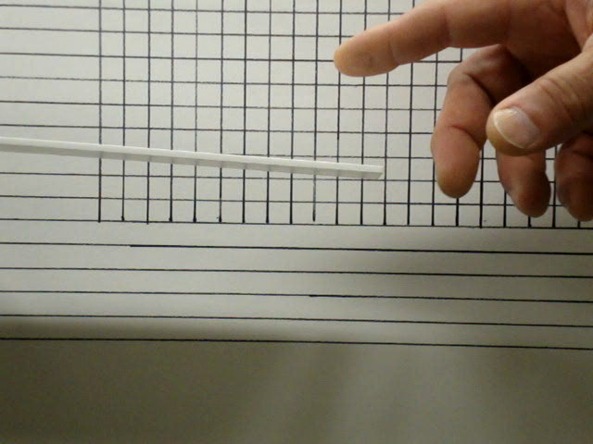
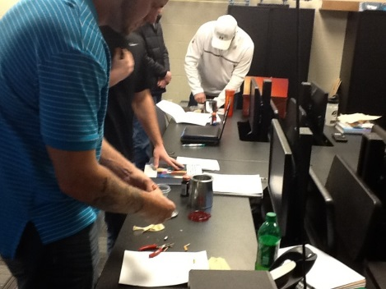
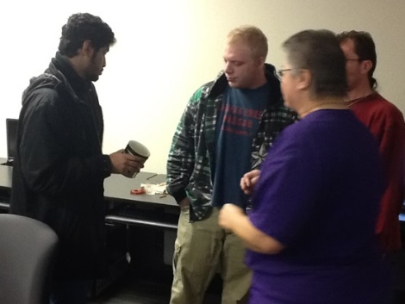
Background
Ivy Tech started its associating with SCME in the Fall of 2012 and has been a Co-PI on Southwest Center for Microsystem Education (SCME) NSF ATE Grant. We also have a NSF ATE small project grant for Microsystems Certification
MEMS Kits Implementation Plan IVY TECH (Fort Wayne & Valparaiso)
 | MEMS Kit | ENGT 120 | METC 111 | METC 143 | EECT 111 | EECT 112 | ENGR 251 | ENGT 279
1 | MEMS: Making Micro Machines Kit | X
2 | Dynamic Cantilever Kit |  | X | X |  |  | X
3 | Crystallography Kit |  |  | X
4 | Pressure Sensor Model Kit | X |  |  | X | X | X
5 | GeneChip Model Kit | X
6 | MEMS Innovators Kit |  |  |  |  |  |  | X
7 | Lift-off Kit |  |  | X | X
8 | Pressure Sensor Process Kit |  |  |  | X
9 | LIGA Micromachining Simulation Kit |  |  | X
10 | Anisotropic Etch Kit |  |  | X | X
11 | Rainbow Wafer Kit | X
http://scme-support.org/

Slide 4
What is an Arduino?
The Arduino is a small inexpensive microcontroller board that allows for easy and popular (electronic) project development.
A microcontroller typically includes, I/O, memory and a microprocessor. It is sort of a mini microprocessor board.
The Arduino is built to accept daughter boards called Shields and there exists many commercially available shield that you can stack onto your Arduino boards.
One of the most common shields is called a prototype shield and it allow the user to develop their own electronics.
The Arduino can be programmed with simple free open source code or even high level or graphically based languages like LabView.
2 - https://www.arduino.cc/

Slide 5
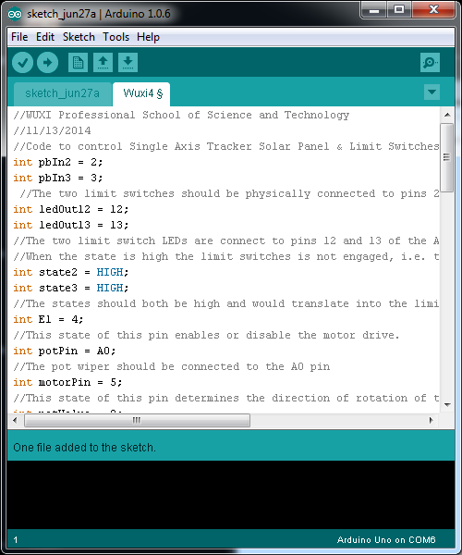
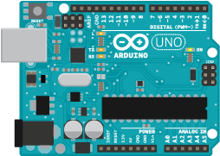
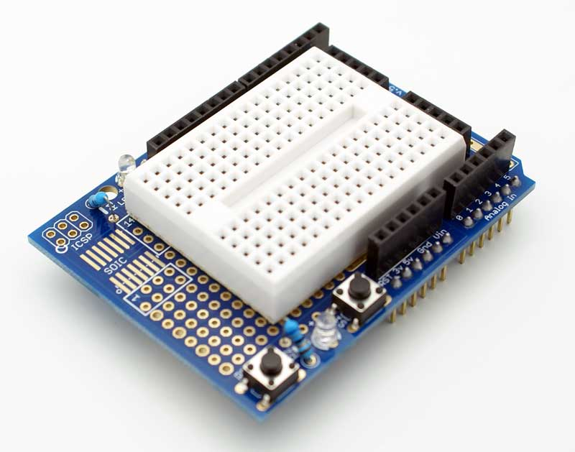
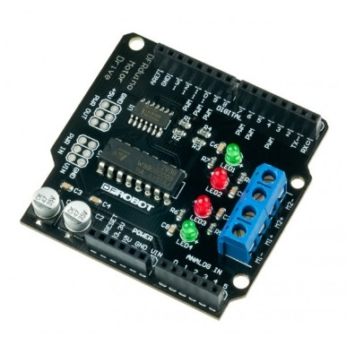
What is an Arduino?
Arduino Uno
Prototype Shield
Open source Arduino Code
https://www.arduino.cc/
Example Arduino Shield

Slide 6
What is LabView?
LabView is graphical based programming language developed by National Instruments and used extensively in industry.
LabView program are called "vi" programs and typically include a block diagram type of program that is programmed via block interconnections of various functional blocks.
LabView program also have a gui interface window that can be designed to allow users to view the data and control the programs.
LabView programs can be executed on computers with LabView installed or compiled and run as standalone programs. To create an executable program you must have a compiler.

Slide 7
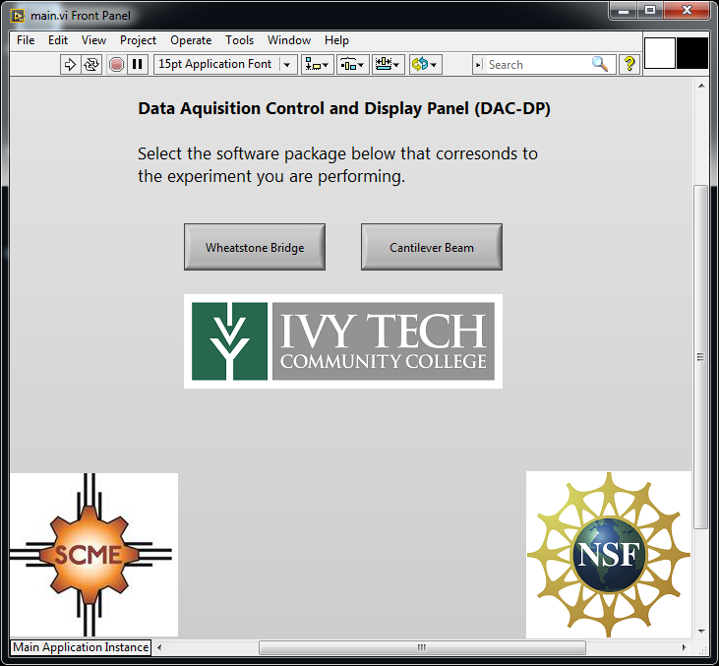
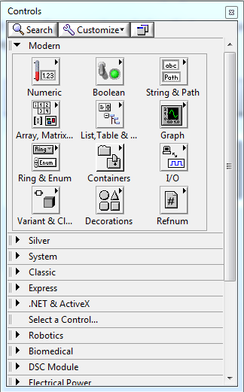
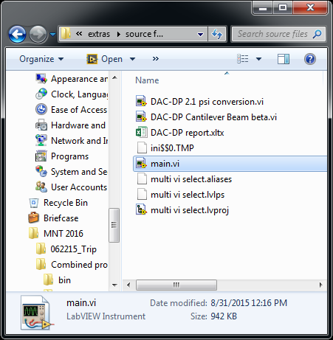
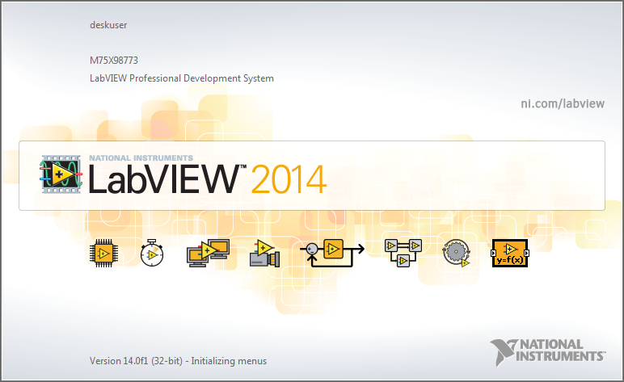
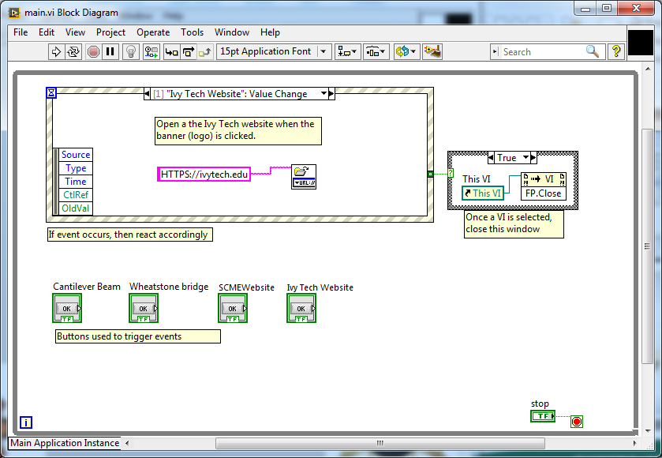
What is LabView?
https://www.ni.com/en-us/support/downloads/software-products/download.labview.html
800-433-3488

Slide 8
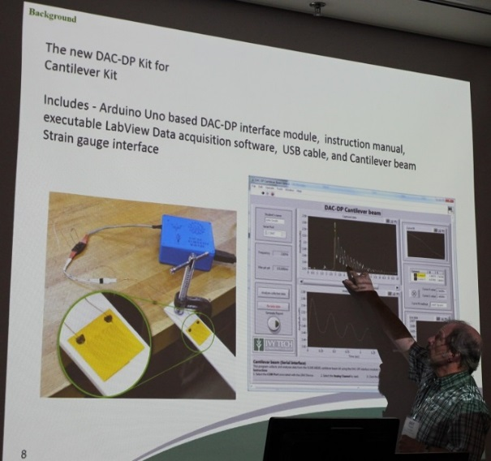
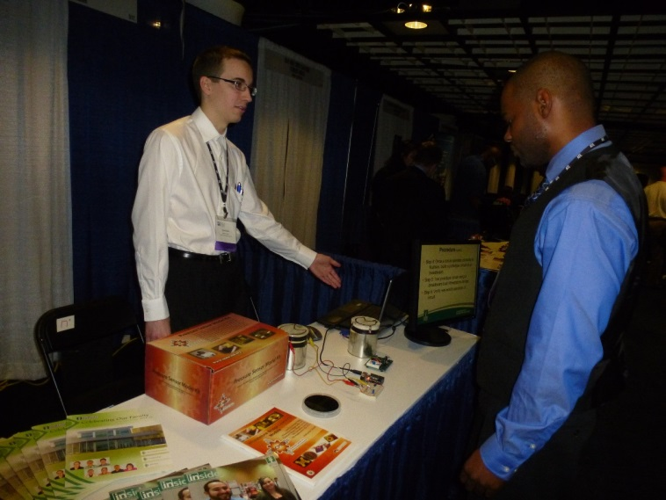
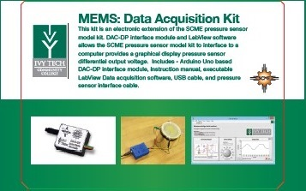
Our Projects?
Design and build electronic kits that could be used in tandem with the SCME³ kits.
These new kits should focus on cost and maximize
student learning
New kits should be developed by student workers
Should be based on Arduino UNO, LabView and
SCME kits
3 - http://scme-nm.org/

Slide 9
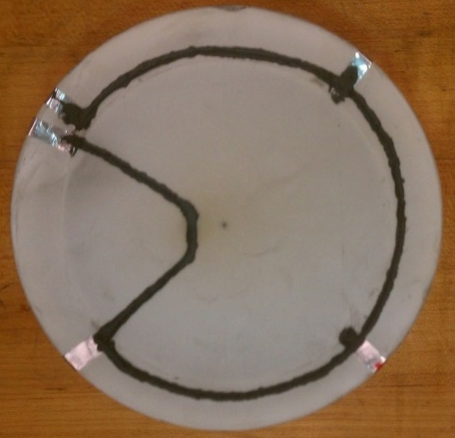
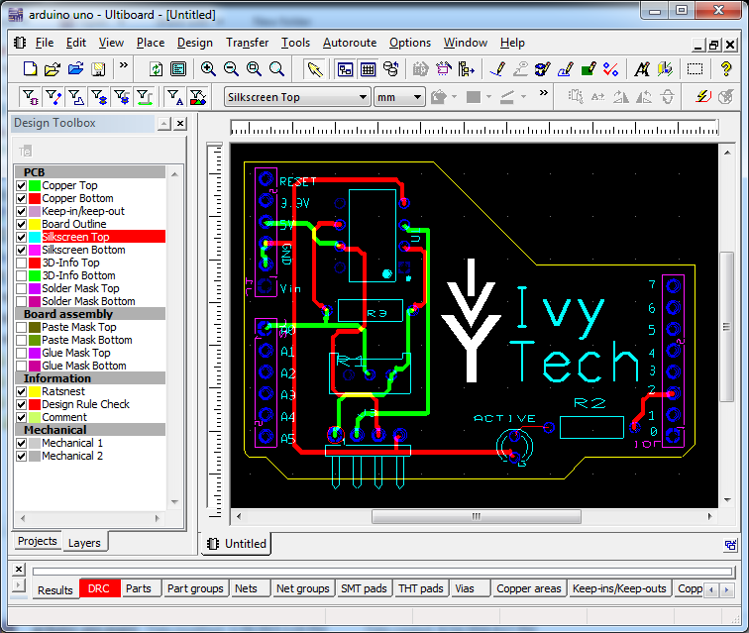
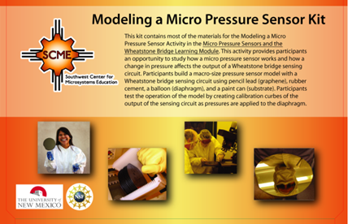
Our Projects?
First up the Pressure Sensor kit => Modeling a Micro Pressure Sensor Kit

Slide 10
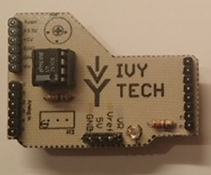
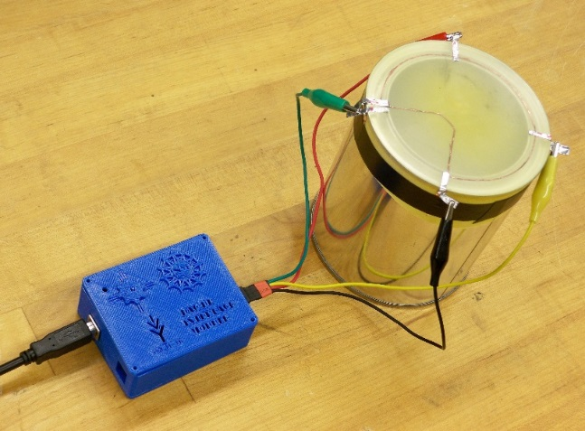
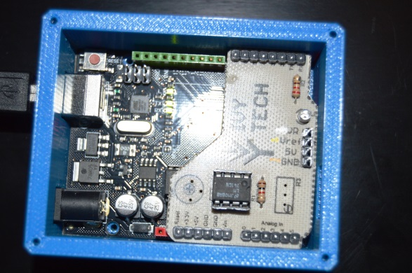
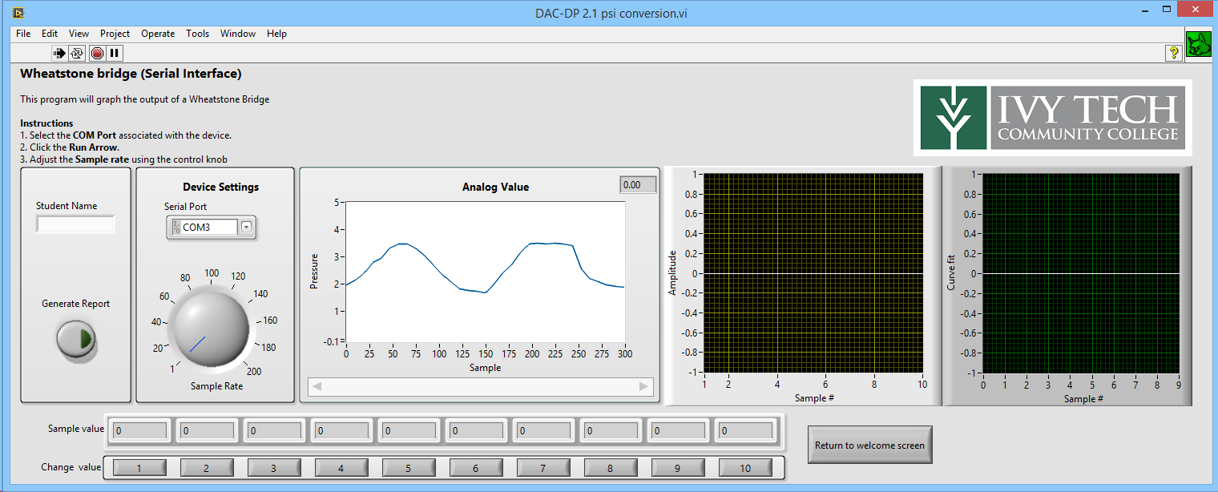
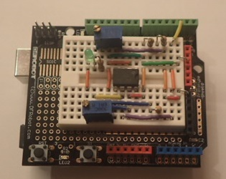
Our Projects?
After many months …

Slide 11

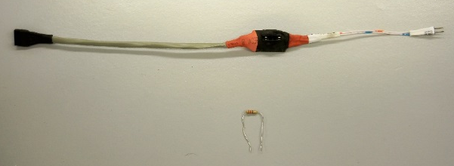
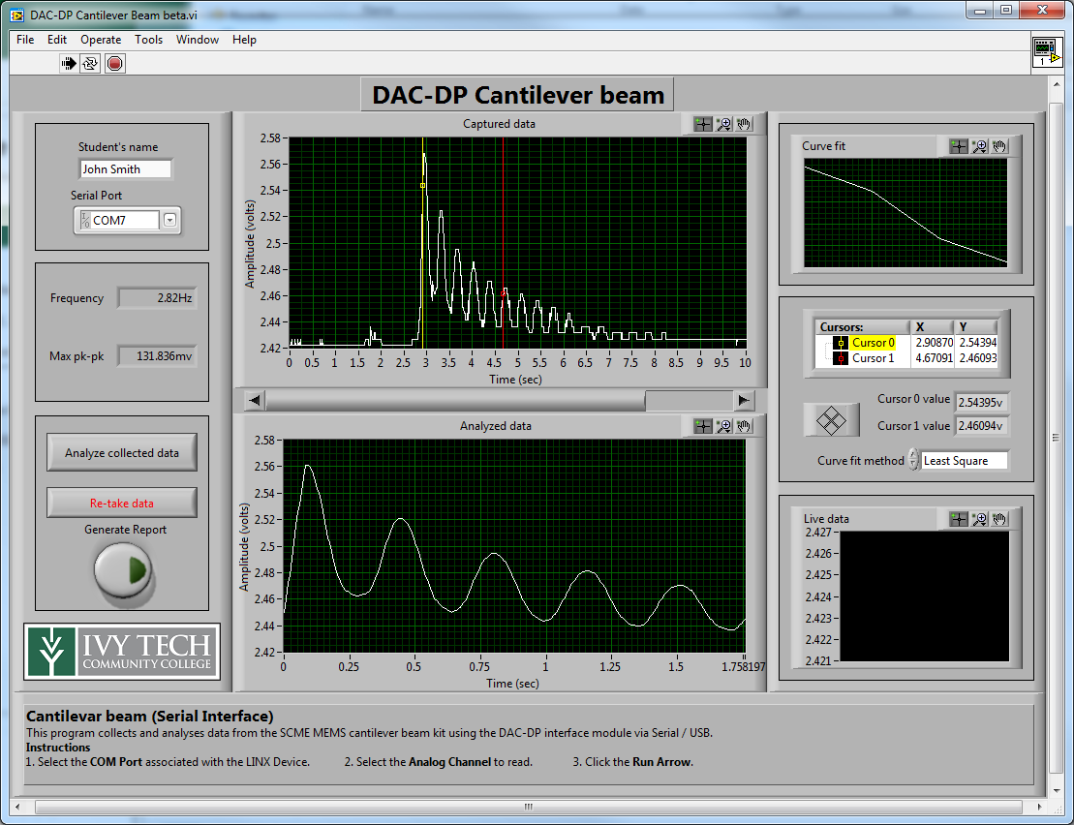
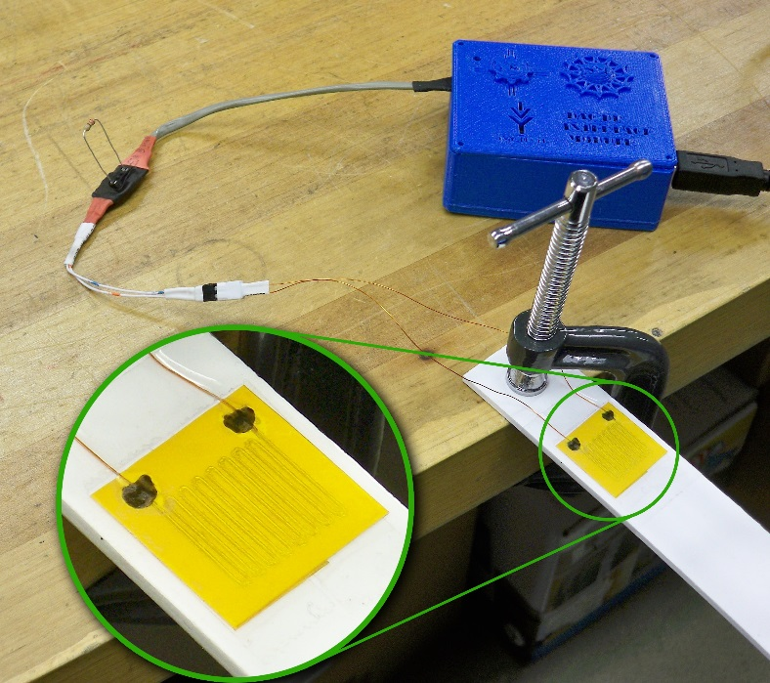
Our Projects?
Second up the Cantilever Beam kit => Microcantilever Model Kit

Slide 12

Questions?
http://scme-support.org/
http://www.ivytech-mems.org/
http://faculty.ivytech.edu/~abell118/
Andy Bell
Department Chair – Engineering
Ivy Tech Community College – Northeast
Phone: 260-481-2288 : Fax: 260-480-2052 : abell118@ivytech.edu
SDKB Technology Center, Room TC1240R, 3800 N. Anthony Blvd.,
Fort Wayne, IN 46805

